Slide 1
Color2Grey
Perceptually Enhanced Color-to-Gray with Versatile Color-Reordering

Slide 2
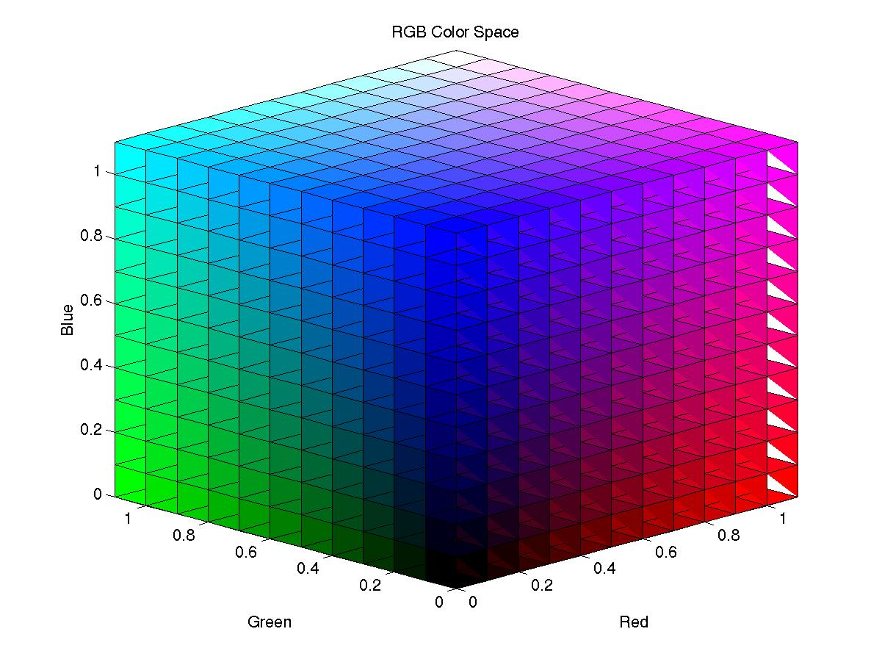
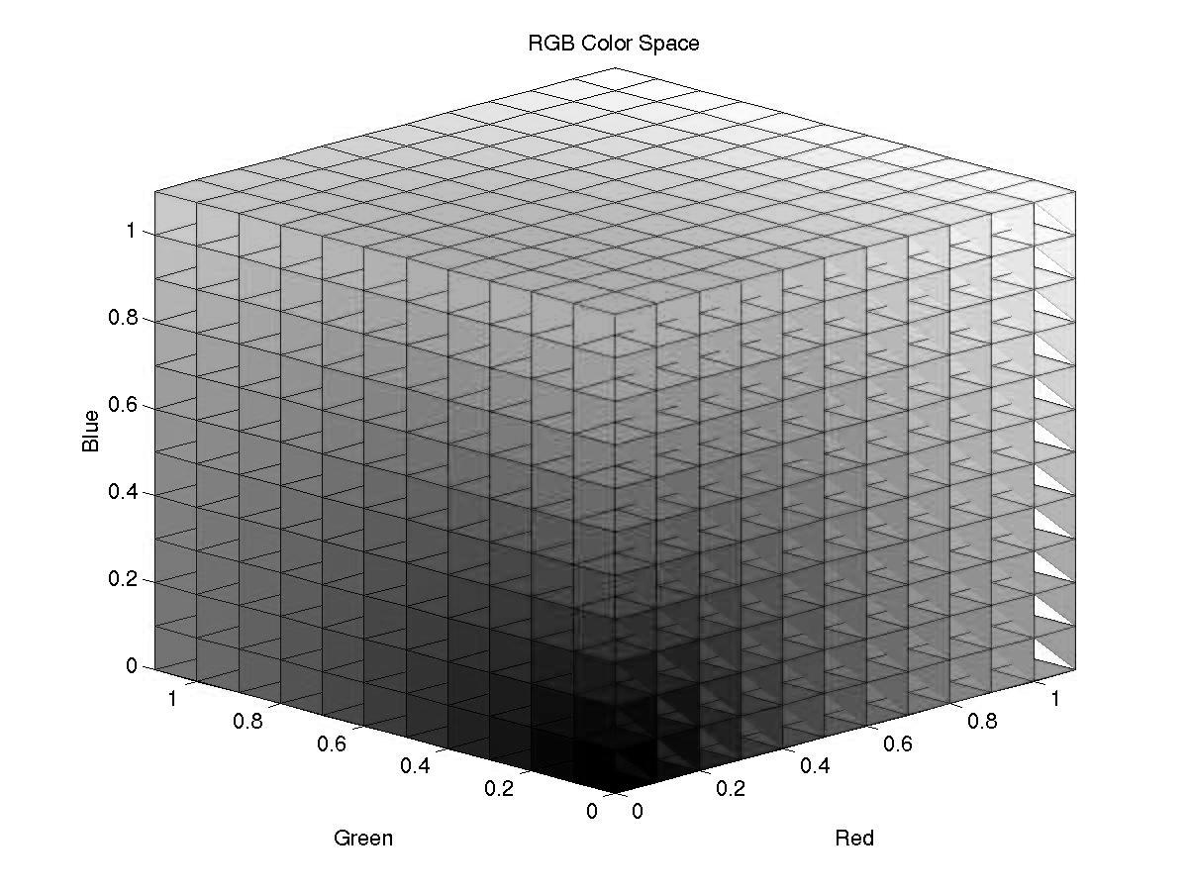
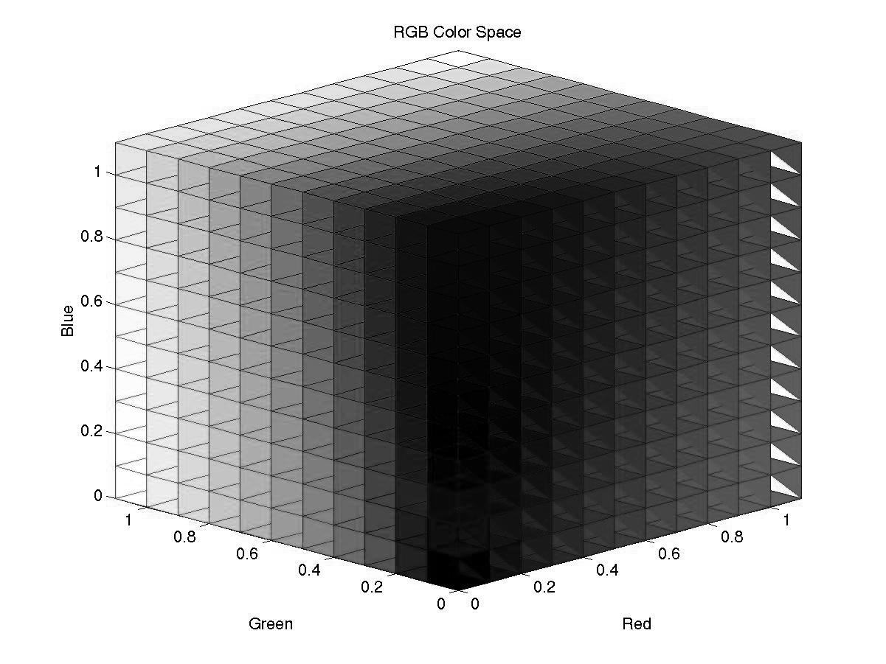
What is color-to-grey?

Slide 3
I assume that everybody has some basis for color spaces and conversions.

Slide 4
Recognize Problems
Preserving saturation and hue contrasts
Generally achieved
Preserving luminance consistency
achieved
Robust Color Ordering*
achieved
Mapping accuracy
achieved
Perceptually pleasing greyscale
Cannot be defined. User study necessary.
Global Mapping Consistency
Achieved
Algorithm Complexity
Fast enough to be user-interactive.

Slide 5
Previously
Color ordering can be a main issue.
[Kim et. al, 2009]
Color discriminability is achieveable.
Visual accuracy generally ensures visually pleasing color-to-grey conversion.
[Cadik et. al, 2008]

Slide 6
Conclusion
Visually accurate conversion
not only accurate and pleasing scenes.
Studies on human perception are crucial.

Slide 7
Our Global Mapping
Helmholtz-Kohlrausch predictor
Nayatani’s research on how human visual system perceives a color.
It is based on the fact that:
Saturation ➔ Perceived intensity
Bezold-Brucke effects
Hue distance and perceived intensity
Non – Linear

Slide 8
Why not CIELab?
It is based on the wrong Von Kries model.
It misses out on some perceptual effects.

Slide 9
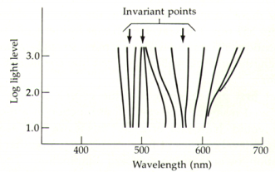
Bezold-Brucke effects
Hurvich ’81, pg 73.

Slide 10
Helmholtz-Kohlrausch predictor
2 Methods
N vac
N vcc

Slide 11
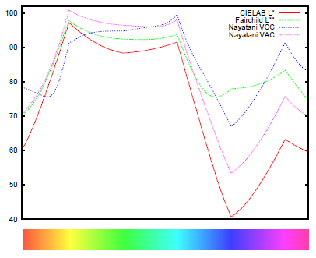

Slide 12
Helmholtz-Kohlrausch predictor
2 Methods
N vac
Decent color ordering
N vcc
May bring an extreme value.
Better for discriminability.

Slide 13
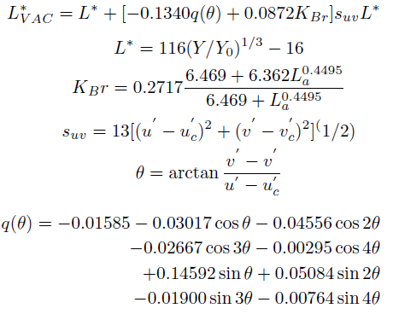
N vac

Slide 14
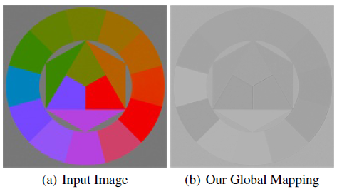
After global mapping…
Problem
Helmholtz-Kohlrausch predictor does not consider hue changes very much.
Extreme Case ➔ a problem-Not distinguishable

Slide 15
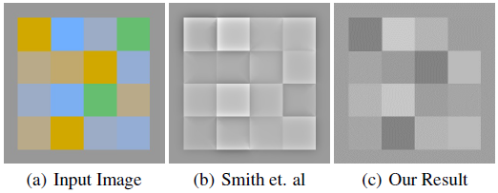
Solution : Local Mapping
Techniques that use local mapping
Gooch, Smith, and etc.

Slide 16
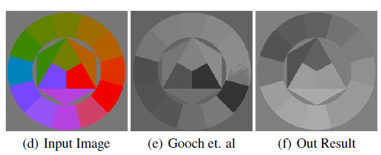
More Problems

Slide 17
We need a different solution.
Local Mapping, but it can work like a global mapping.
Incorporate PCA(Principal Component Analysis)
Use IADCA
Image Adaptive Difference Component Analysis

Slide 18
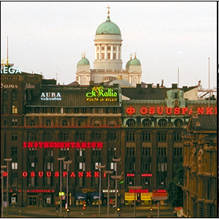
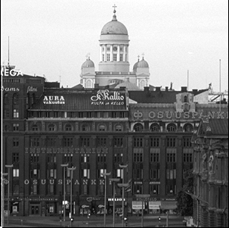
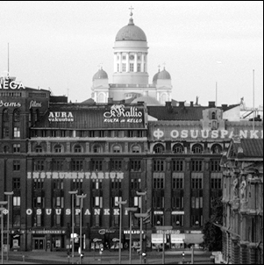
Why IADCA ?
How would you convert the color?
What is most obvious? (Red sign? White sign?)

Slide 19
How we perceive is related to the image.
We need an image adaptive conversion.
IADCA
Image Adaptive Difference Component Analysis
Image-Adaptive Difference Component Analysis

Slide 20
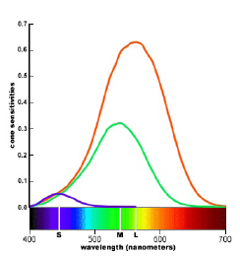
More
Our cones and rods are distributed through our eyes.
Perceive some particular colors more.

Slide 21
Image Adaptive + Color Perception
Compute difference between the human visual system and normal color space.
Has to be image adaptive.

Slide 22
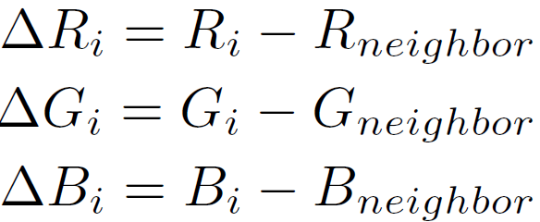
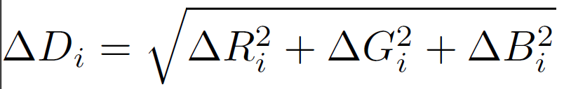
IADCA
Formula
We pick one neighbor pixel using Gaussian distribution.

Slide 23
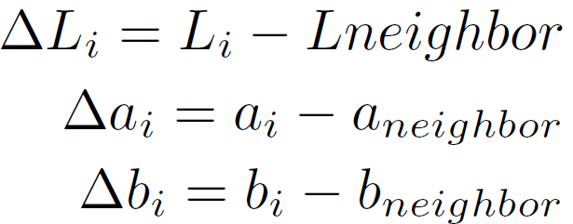
IADCA

Slide 24
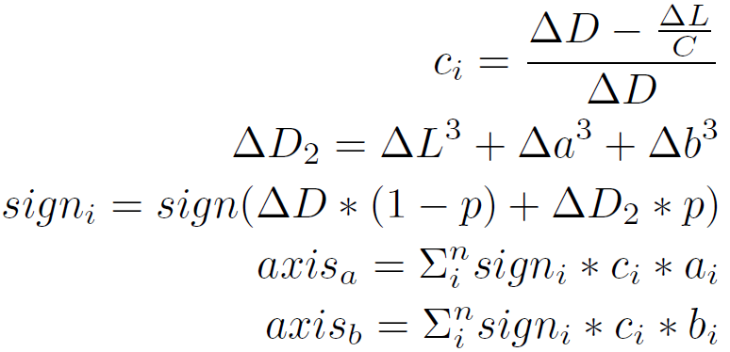
Notice user-variable p

Slide 25
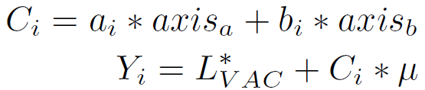
Now we know axis

Slide 26
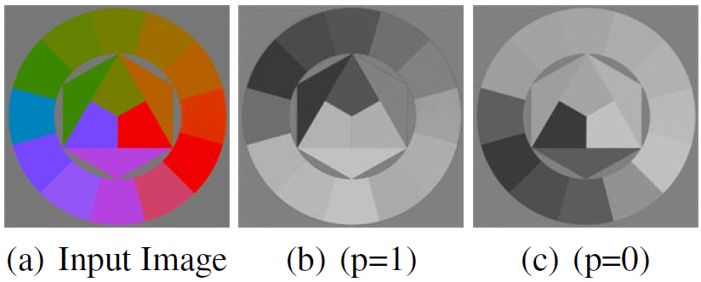
User-defined variable p
Users can manipulate color-ordering.
Hue Order Manipulation

Slide 27
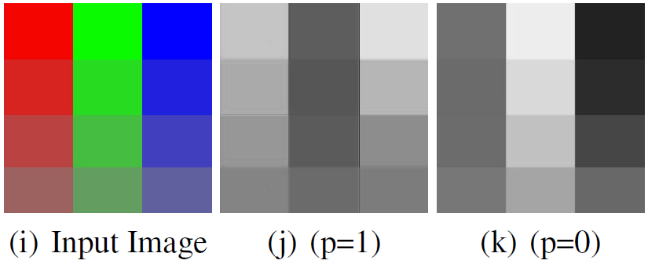
Just Hue? Saturation as well
Users can manipulate color-ordering.
Saturation Order Manipulation

Slide 28
Result
Complexity
Fast enough
About 0.3 seconds for a conversion
(200x198x24bit-color image)
See the paper.

